Slide 1
Medical AI
Lee DongNyoung
Sohaib Abdullah
Pham Van Linh
GROUP 2

Slide 2
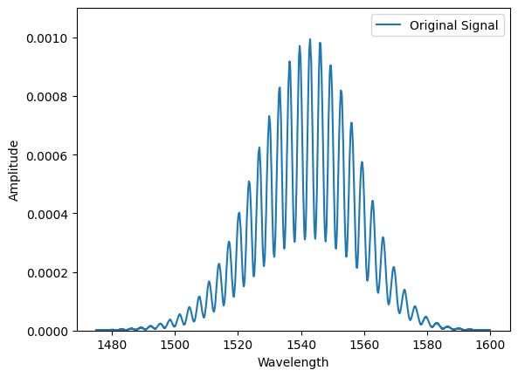
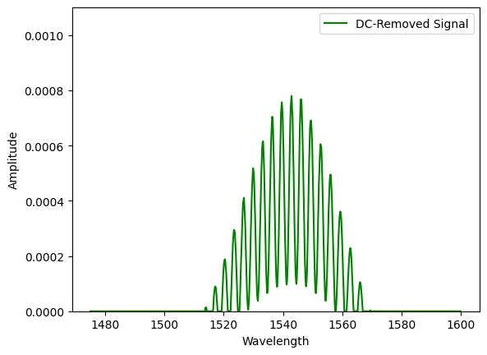
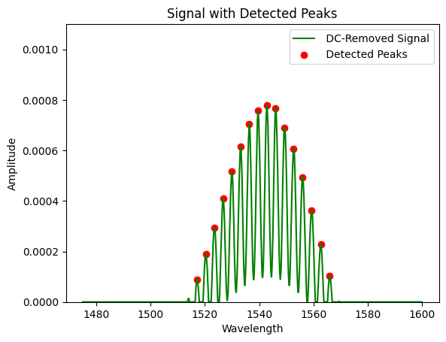
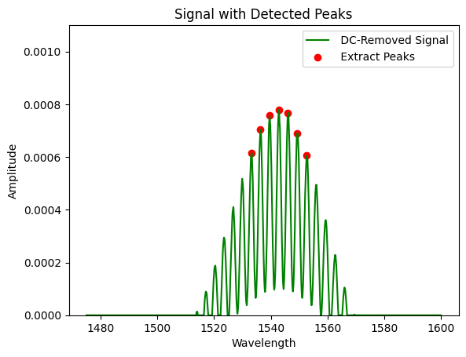
Features from single data
1
2
3
4

Slide 3

stack whole data
Single data
[x₁ x₂ x₃ x₄ x₅ y₁ y₂ y₃ y₄ y₅]
Whole data
[x₁ x₂ x₃ x₄ x₅ y₁ y₂ y₃ y₄ y₅] ₁
[x₁ x₂ x₃ x₄ x₅ y₁ y₂ y₃ y₄ y₅] ₂
………………………………
[x₁ x₂ x₃ x₄ x₅ y₁ y₂ y₃ y₄ y₅] ₂₅₀
[x₁ x₂ x₃ x₄ x₅ y₁ y₂ y₃ y₄ y₅] ₂₅₁

Slide 4
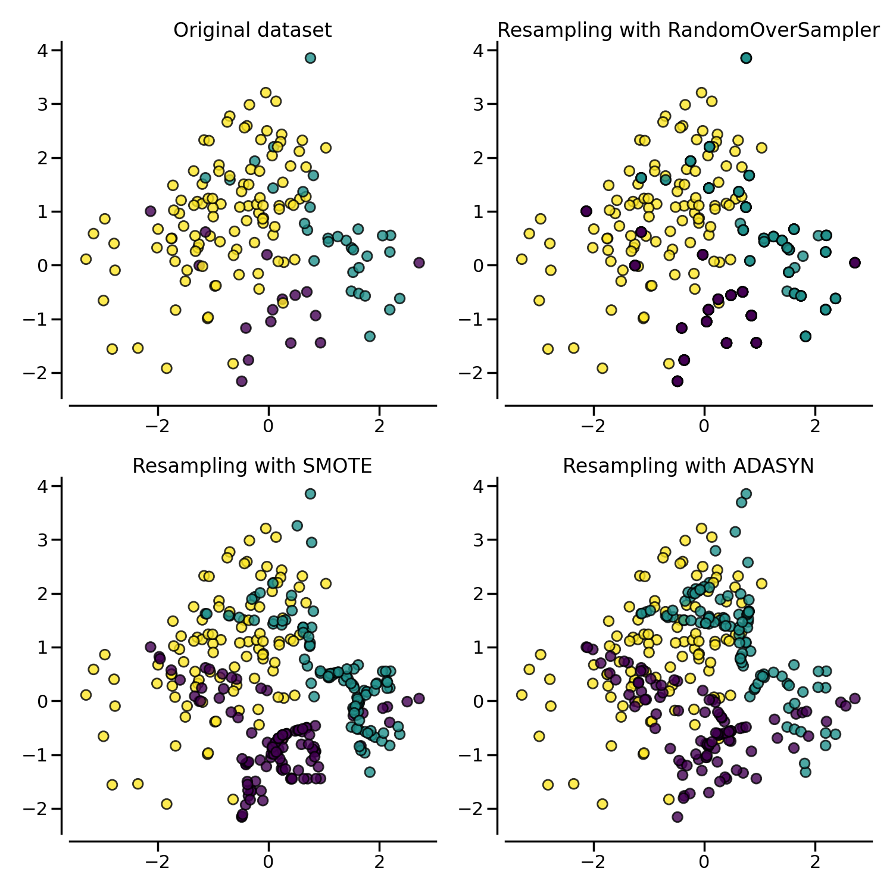
Balancing dataset
label 4: 144
label 2: 72
label 3: 12
label 1: 12
label 0: 11
label 4: 144
label 2: 144
label 3: 144
label 1: 144
label 0: 144

Slide 5
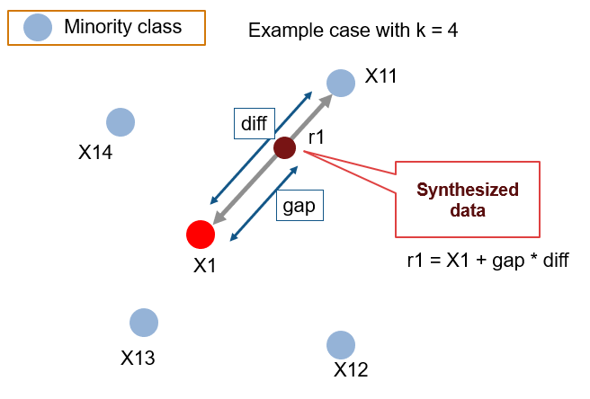
Balancing dataset
label 4: 144
label 2: 72
label 3: 12
label 1: 12
label 0: 11
label 4: 144
label 2: 144
label 3: 144
label 1: 144
label 0: 144

Slide 6
Final dataset
original data: (251, 50)
features: 25 peaks (Wave length, Amplitude)
[Y_max+1, Y_max-1, X_max+1, X_max-1, ... , X_max, Y_max]
Final data: (480, 50)
each label has 96 data
lable: (251, 1)
2 classfication: (0: normal), (1: Worst)
5 classification: (0: normal), (1: Cin1), (2: Cin2), (3: Cin3), (4: Worst)

Slide 7
CLASSIFICATION Comparison
Model | Over- Sampling Method | Accuracy (%)
 |  | Normal | ClN1 | CIN2 | CIN3 | Worst | Overall
KNN | SMOTE | 97 | 79 | 73 | 96 | 84 | 85.4
 | ADASYN | 00 | 00 | 80 | 67 | 94 | 88.2
DECISION TREE | SMOTE | 100 | 96 | 94 | 100 | 91 | 95.8
 | ADASYN | 100 | 97 | 90 | 100 | 94 | 95.9
RANDOM FOREST | SMOTE | 100 | 100 | 91 | 100 | 97 | 97.2
 | ADASYN | 100 | 100 | 100 | 100 | 97 | 99.3
Gradient BOOSTING | SMOTE | 100 | 96 | 94 | 100 | 88 | 95.1
 | ADASYN | 100 | 100 | 97 | 100 | 94 | 97.9
XGBOOST | SMOTE | 100 | 100 | 100 | 100 | 97 | 99.3
 | ADASYN | 100 | 97 | 97 | 100 | 94 | 97.2

Slide 8
CLASSIFICATION Comparison

Slide 9
CLASSIFICATION: Analyze
Model: XGBoost
Oversampling: SMOTE
Data(480, 50), Label(5 classification)
Overall accuracy: 92.10%
Accuracy of each label
Normal(0): 100%
CIN 1(1): 100%
CIN 2(2): 81%
CIN 3(3): 75%
Worst(4): 98%

Slide 10
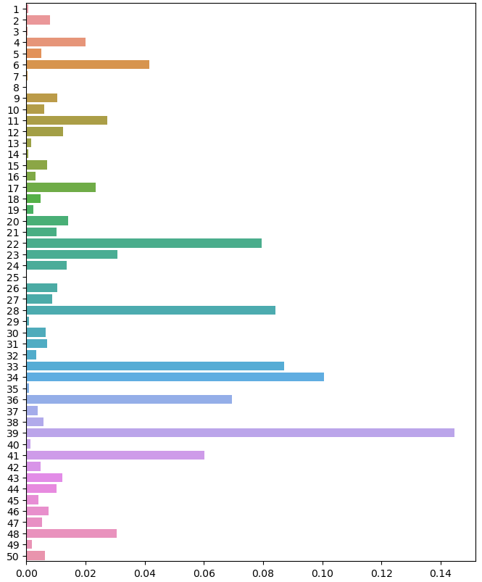
Parameters weight
Top 5
index 39: 14.47%
index 34: 10.08%
index 33: 8.70%
index 28: 8.42%
index 22: 7.94%

Slide 11
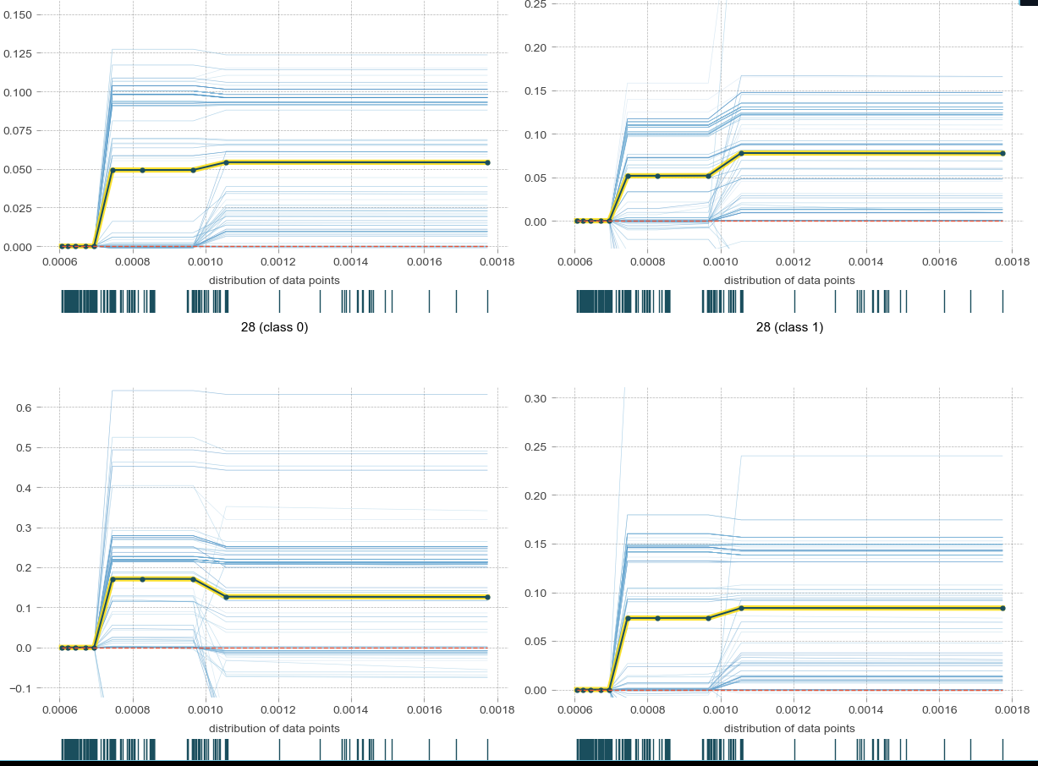
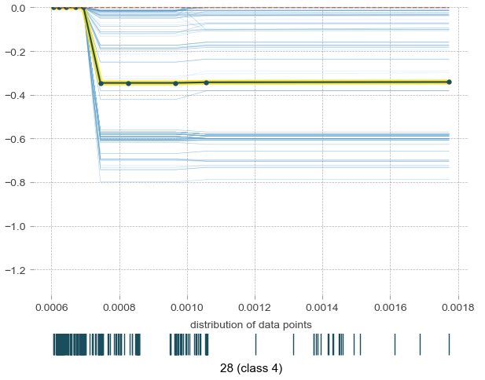
Isolate plot
Index: 28
can detect the ‘worst’ label

Slide 12
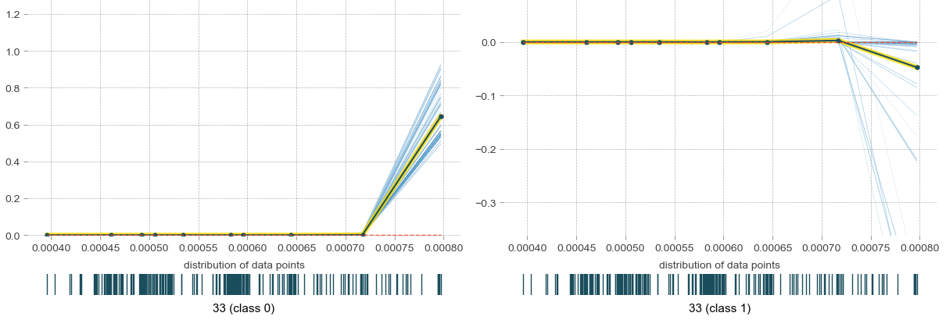
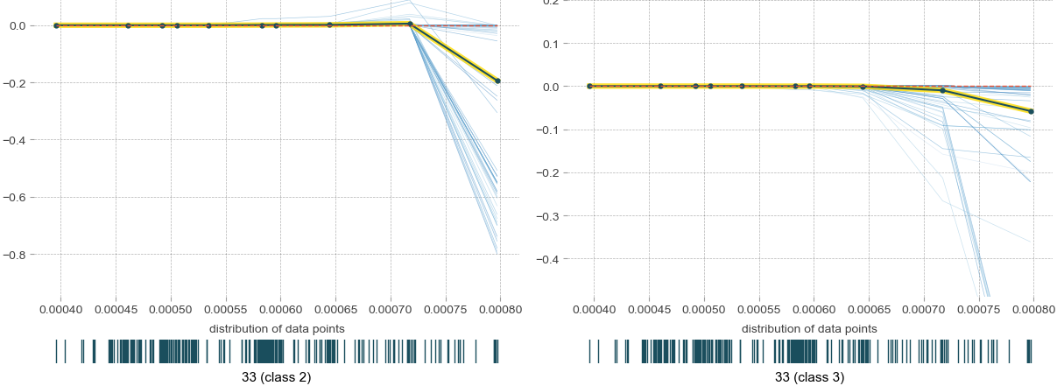
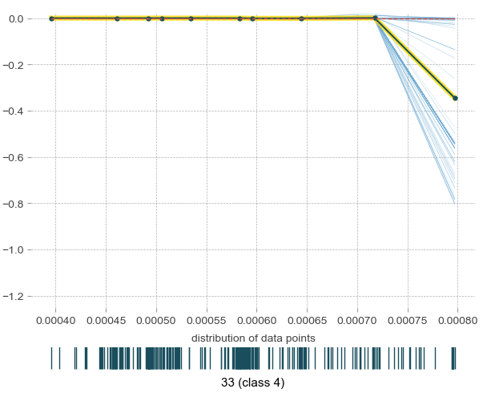
Isolate plot
Index: 33
can detect the ‘normal’ label

Slide 13
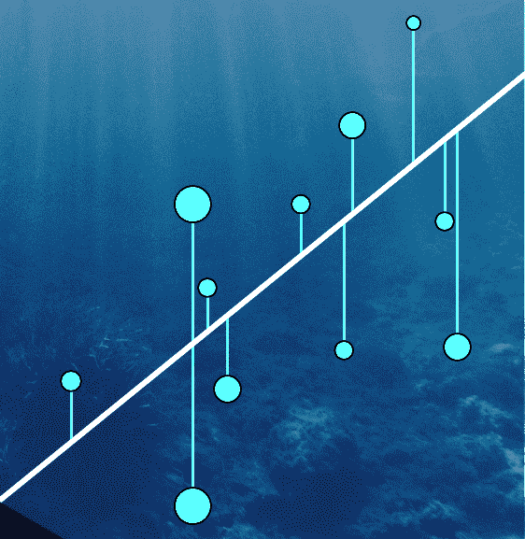
Regression: Random forest
Regression models the relationship between variables.
It assumes a linear relationship.
It aims to minimize the difference between observed and predicted values.
Parameters like slope and intercept are estimated.
Widely used in predictive modeling and understanding correlations.

Slide 14
regression: RESULTS
Model | Over- Sampling Method | Error
 |  | Mean Absolute Error (MAE)
KNN | SMOTE | 0.12
 | ADASYN | 0.11
DECISION TREE | SMOTE | 0.06
 | ADASYN | 0.06
RANDOM FOREST | SMOTE | 0.05
 | ADASYN | 0.08
Gradient BOOSTING | SMOTE | 0.04
 | ADASYN | 0.06

Slide 15
REGRESSION RESULTS COMPARISON

